Slide 2
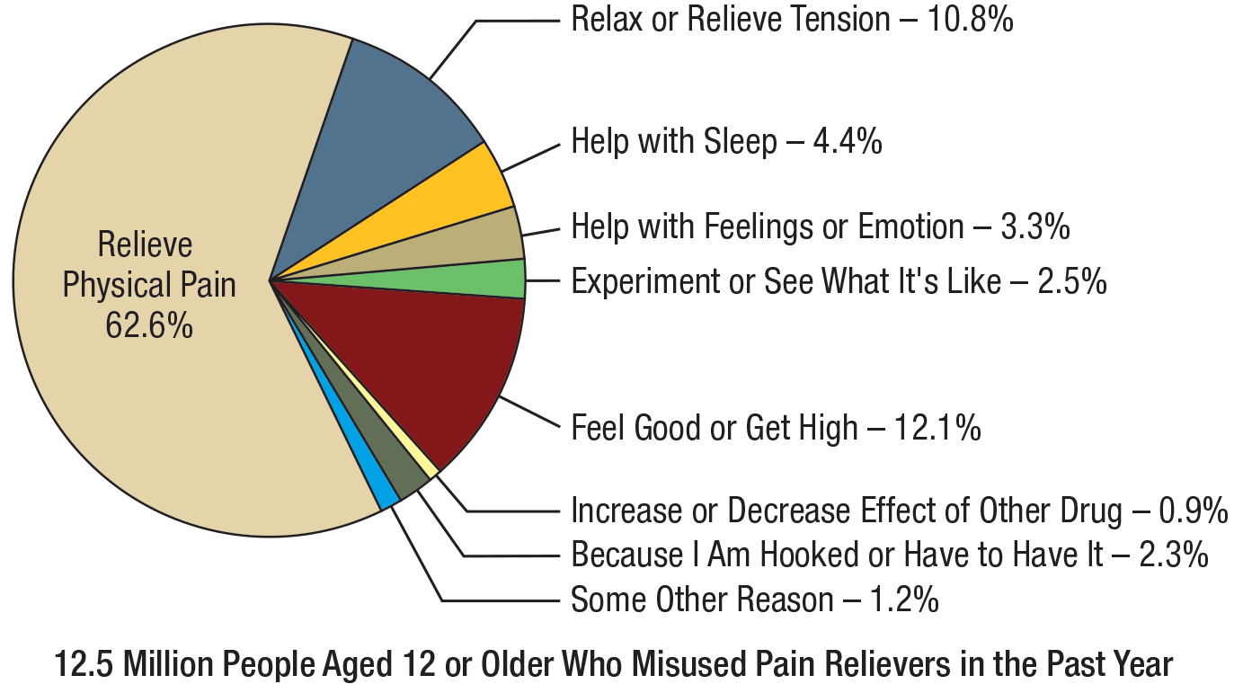
Main Reasons for the Most Recent Misuse of Pain Relievers among People Aged 12 or Older Who Misused Prescription Pain Relievers in the Past Year: Percentages, 2015 NSDUH
FFRX.08
‹#›
Note: The percentages do not add to 100 percent due to rounding.
Note: Respondents with unknown information for their main reason for misuse were excluded.

Slide 3
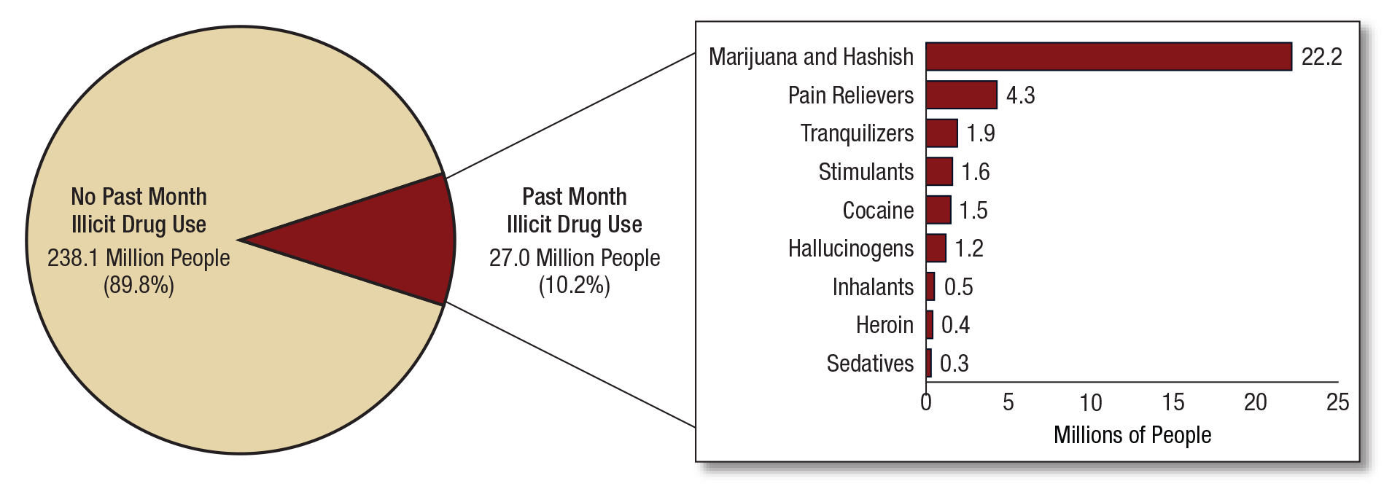
Numbers of Past Month Illicit Drug Users among People Aged 12 or Older: 2015
FRR1.01
Note: Estimated numbers of people refer to people aged 12 or older in the civilian, noninstitutionalized population in the United States. The numbers do not sum to the total population of the United States because the population for NSDUH does not include people aged 11 years old or younger, people with no fixed household address (e.g., homeless or transient people not in shelters), active-duty military personnel, and residents of institutional group quarters, such as correctional facilities, nursing homes, mental institutions, and long-term hospitals.
Note: The estimated numbers of current users of different illicit drugs are not mutually exclusive because people could have used more than one type of illicit drug in the past month. Illicit Drugs include marijuana/hashish, cocaine (including crack), heroin, hallucinogens, inhalants, or prescription-type psychotherapeutics used nonmedically.
‹#›

Slide 4
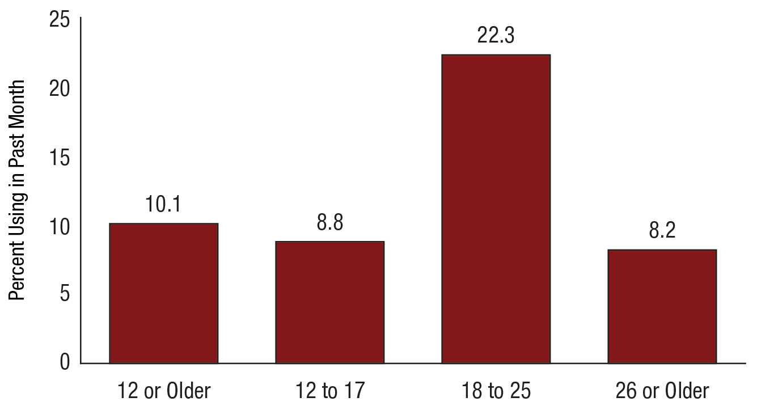
Past Month Illicit Drug Use among People Aged 12 or Older, by Age Group: Percentages, 2015 NSDUH
FFR1.02
‹#›

Slide 5
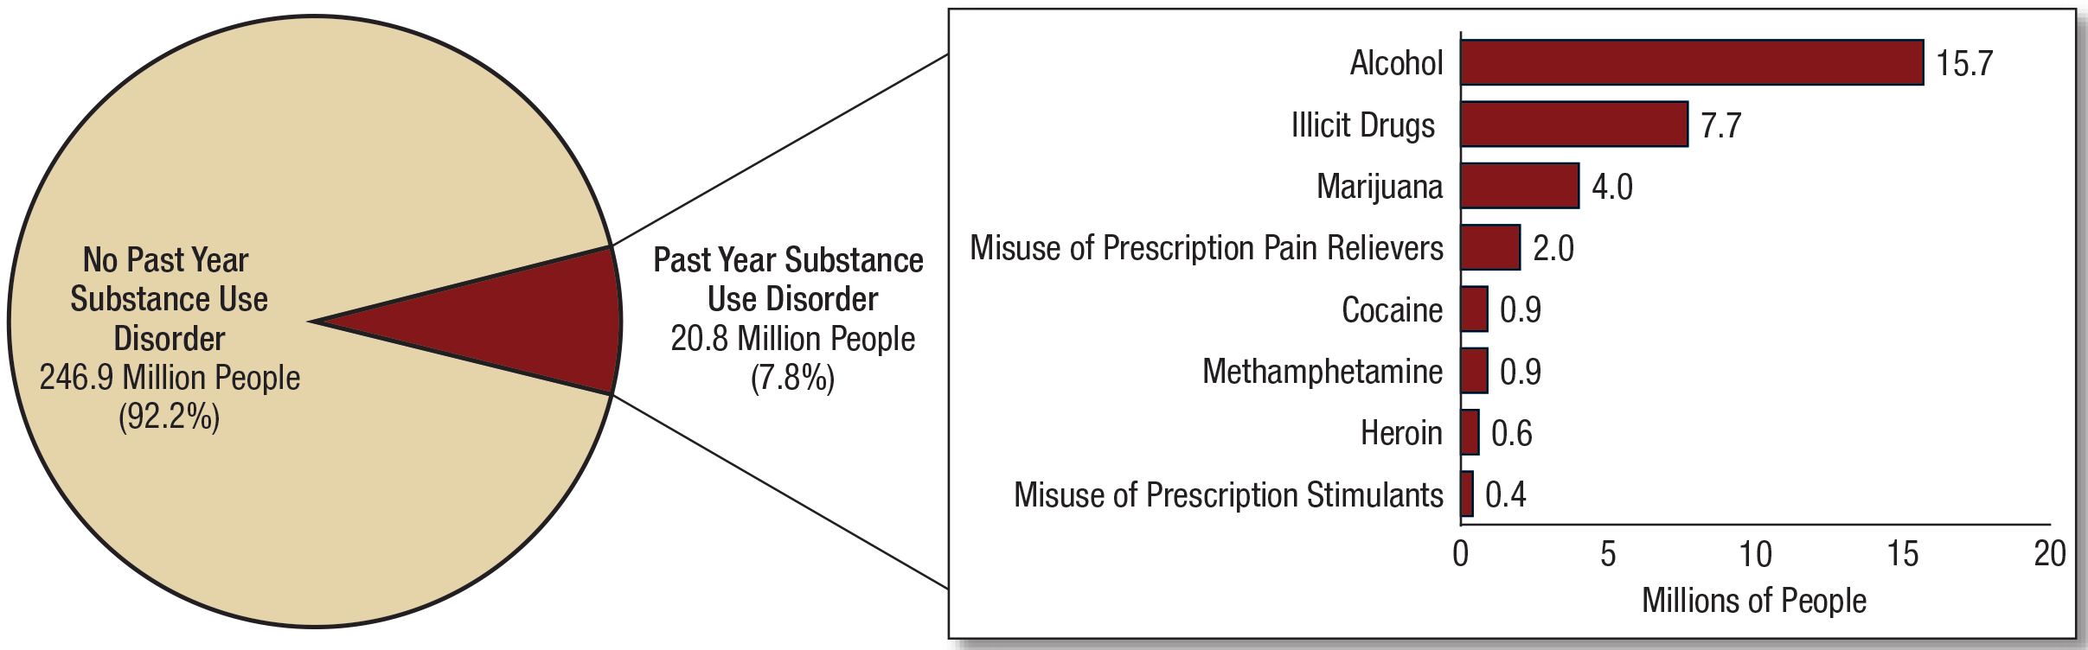
Numbers of People Aged 12 or Older with a Past Year Substance Use Disorder: 2015 NSDUH
FFR1.27
Note: Estimated numbers of people refer to people aged 12 or older in the civilian, noninstitutionalized population in the United States. The numbers do not sum to the total population of the United States because the population for NSDUH does not include people aged 11 years old or younger, people with no fixed household address (e.g., homeless or transient people not in shelters), active-duty military personnel, and residents of institutional group quarters, such as correctional facilities, nursing homes, mental institutions, and long-term care hospitals.
Note: The estimated numbers of people with substance use disorders are not mutually exclusive because people could have use disorders for more than one substance.
‹#›

Slide 6
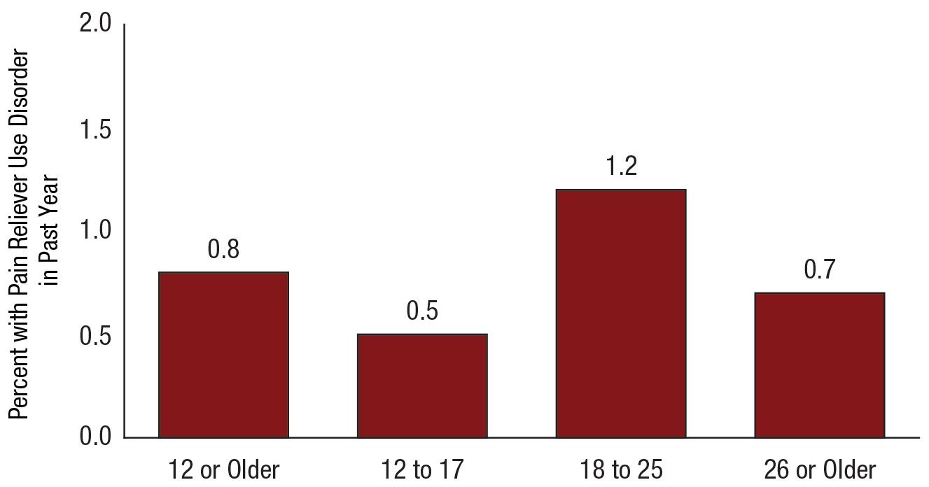
Pain Reliever Use Disorder in the Past Year among People Aged 12 or Older, by Age Group: Percentages, 2015 NSDUH
FFR1.35
‹#›

Slide 7
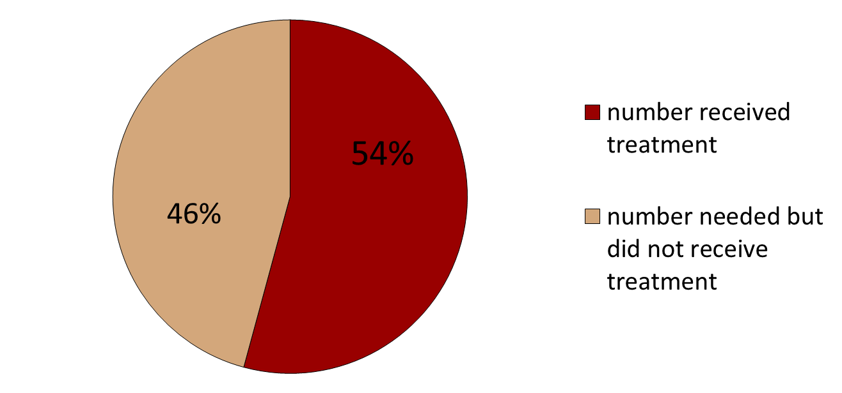
Treatment Receipt for OUD 2015
Source: NSDUH Number Received: 1430000, Number did not receive: 1208000
‹#›

Slide 8
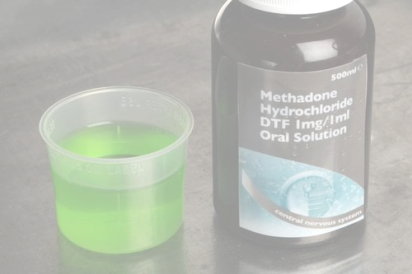
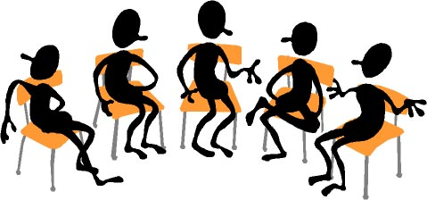
How is OUD Treated?
Medication:
Methadone (outpatient clinics)
Buprenorphine (doctors’ office)
Monthly injected naltrexone
People also use:
Residential Rehab
IOP/OP Counseling
Recovery Support
Self Help
Supply does not meet demand
Failure rates significant
‹#›

Slide 9


Resources
‹#›

Slide 10
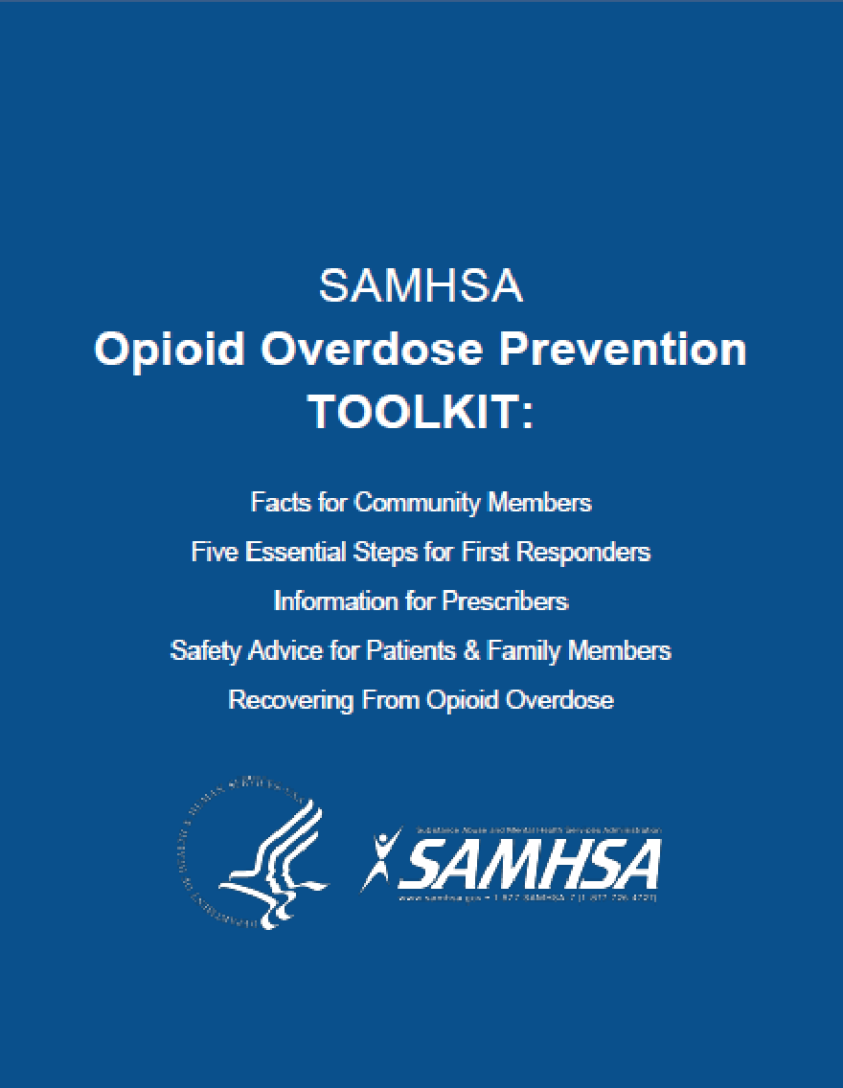
Resources
‹#›

